Slide 1
Categorical and Dichotomous Variables and Interaction Terms
Regression Analysis and Non-Linear Models: Sociology 6100
Dr. Matsuo

Slide 2
Categorical Variables (nominal or ordinal)
E.g., Race, social class, letter grade
Using a categorical variable which has three or more categories in MRA is a violation of assumption
Solution
Create dichotomous variables for the appropriate number of categories
E.g. Race (White, African American, Latino/na, Asian, other)
In the equation, select one category as a reference category.
 | White | AA | Latino | Asian | Other
White | 1 | 0 | 0 | 0 | 0
AA | 0 | 1 | 0 | 0 | 0
Latino | 0 | 0 | 1 | 0 | 0
Asian | 0 | 0 | 0 | 1 | 0
Other | 0 | 0 | 0 | 0 | 1

Slide 3
Dichotomous Variables
Example (demonstrate recoding?)
Dummy Code: Sex (male=1, female=0)
Race (white=1, non-white=0)
Type of school (public=1, private=0)
Another example: Surgery outcome, based on whether or not person has health insurance, etc.
Selection of a reference category needs to be theoretically-based.
e.g. Five racial categories ((White, African American, Latino/na, Asian, other)
Which category becomes a reference category?

Slide 4
Dichotomous Variables (cont.)
OLS Regression Analysis with Sexual Behavioral Change as Dependent Variable
(Standardized) | Model 1 | Model 2
Sex (male=1, female=0) | 0.498 * | 0.426 *
 | (0.107) | (0.092)
Age | -0.013 | -0.003
 | (-0.022) | (-0.006)
Marital Status (married=1, not married=0) | -0.792 * | -0.313 *
 | (-0.133) | (-0.045)
Number of partners | 0.004 | -0.013
 | (0.016) | (-0.051)
Know someone with AIDS (yes=1, no=0) | 0.45 | 0.452
 | (0.089) | (0.097)
Had STD (yes=1, no=0) | -0.646 | -0.717
 | (-0.086) | (-0.097)
Tested for HIV (yes=1, no=0) | 1.403 *** | 1.260 ***
 | (0.205) | (0.184)
Knowledge |  | 0.264 ***
 |  | (0.199)
Attitude |  | -0.083 **
 |  | (-0.134)
Confidence in Sexual Practice |  | 0.295 ***
 |  | (0.297)
Belief |  | -0.196
 |  | (-0.018)
Constant | 7.318 *** | 2.148 ***
R2 | 0.128 | 0.257
* p < 0.05 ** p < 0.01 *** p < 0.001

Slide 6
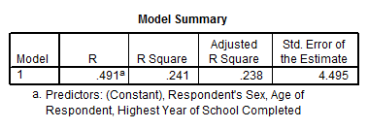
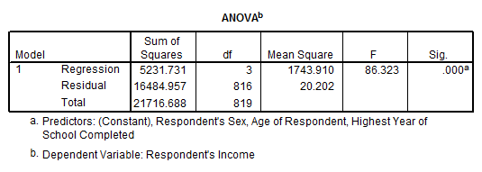
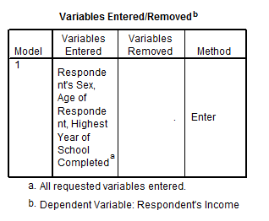
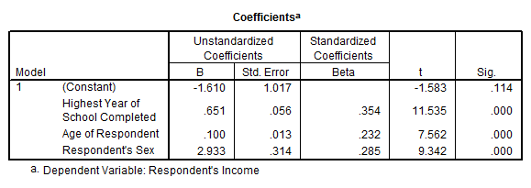
Variables (cont.)
Male=1, female=0
β for sex is 2.933.

Slide 7
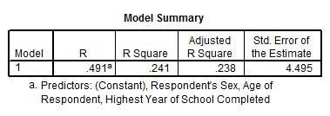
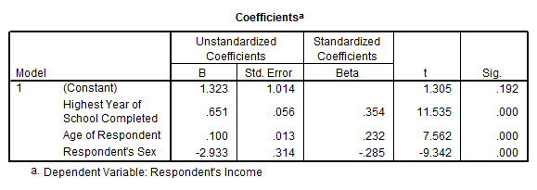
Variables (cont.)

Slide 8
Interaction Terms
Product of multiplication of dichotomous variable and ratio variable.
e.g. Although education has impact on income, the magnitude of its impact varies between men and women.
e.g. Although parents’ SES has impact on child’s academic success, the magnitude of its impact varies among different racial groups.
What is your prediction?

Slide 9
Interaction Terms (cont.)
Scenario 1: Although productivity has impact on salary increase, salary was originally different between men and women.
Base model
Y= α + βX
D: Dichotomous variable (1=male, 0=female)
Y= α + β₁D + β₂X
When D=1, Y= (α + β₁) + β₂X (equation for males)
When D=0, Y= α + β₂X (equation for females)
H₀: β₁=0
If H₀ is rejected, the model suggests that there is a gender difference in the beginning.

Slide 10
Interaction Terms (cont.)
Scenario 2: Although there is no gender difference in the beginning, the magnitude of impact of productivity is different between men and women.
Base model
Y= α + β X
D: Dichotomous variable (1=male, 0=female)
Z: Interaction term (Z=D*X, interaction of productivity and sex)
Y= α + β₁Z + β₂X
Y= α + β₁D*X + β₂X
When D=1, Y= α + β₁X + β₂X
Y= α + (β₁+β₂)X (equation for males)
When D=0, Y= α + β₂X (equation for females)
H₀: β₁=0
If H₀ is rejected, the model suggests that the magnitude of impact of productivity is
different between men and women.

Slide 11
Interaction Terms (cont.)
Scenario 3: Salary was originally different between men and women, and the magnitude of impact of productivity is also different between men and women.
D: Dichotomous variable (1=male, 0=female)
Z: Interaction term (Z=D*X, interaction of productivity and sex)
Y= α + β₁D + β₂D*X + β₃X
When D=1, Y= α + β₁+ β₂X + β₃X
Y= (α + β₁)+ (β₂+β₃)X (equation for males)
When D=0, Y= α + β₃X (equation for females)
H₀: β₁=0 and Β₂=0
If H₀s are rejected, the model suggests that salary was originally different between men and women, and the magnitude of impact of productivity is also different between men and women.

Slide 12
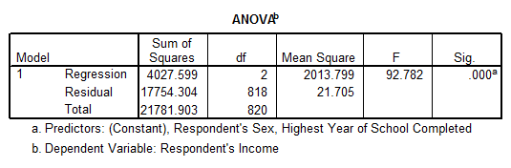
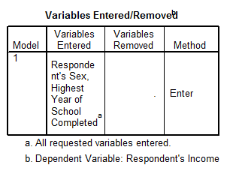
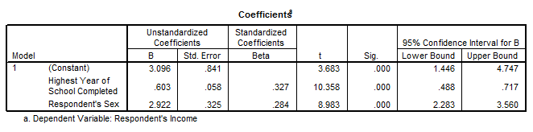
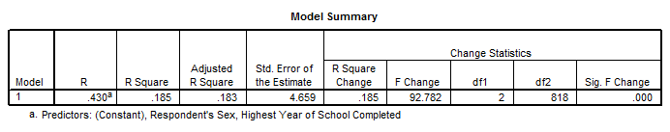
Interaction Terms (cont.)

Slide 13
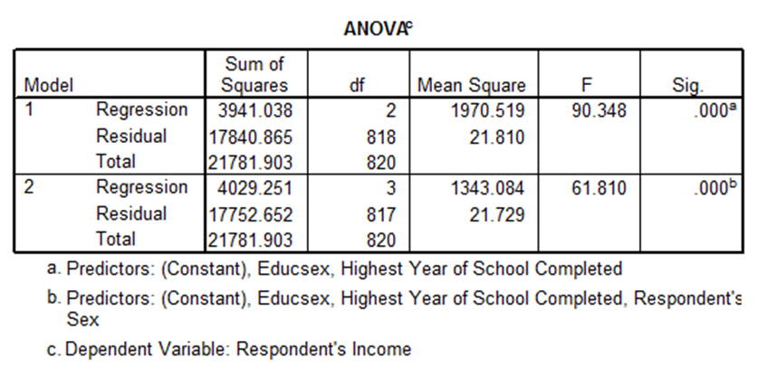
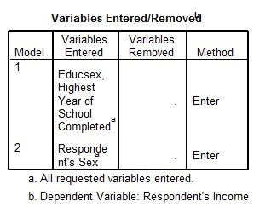
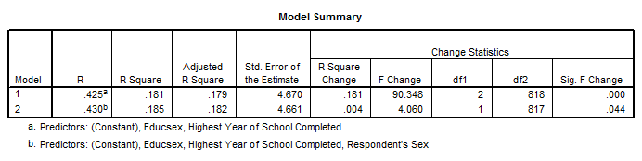
Interaction Terms (cont.)

Slide 14
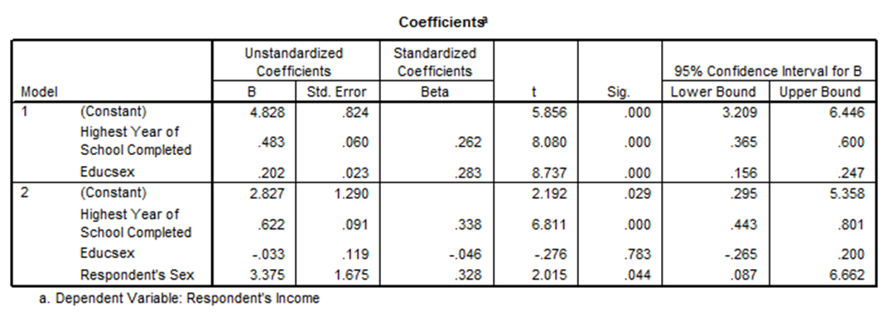
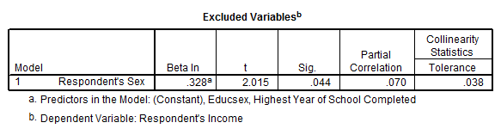
Interaction Terms (cont.)

Slide 18
Questions?

